Slide 1

Bike Accessories Management System
UI/UX Report presentation
Submitted by: Sabarirajan G
Batch No: J36

Slide 2
Introduction
This JavaFX‑based desktop application is designed to help bike accessory stores manage their products, sales, and employees efficiently.
It consists of two modules:
Admin Module
Employee Module

Slide 3
Goals of UI/UX
Manual sales recording and inventory updates often lead to inaccurate stock data.
Lack of real‑time stock visibility makes it hard to manage inventory.
Generating sales reports manually is slow and inconvenient.
Instant feedback for actions

Slide 4
Target Users
Admin
Product Management: Add new products, update stock availability, and categorize products.
Low Stock Alerts: View and update low‑stock notifications.
Sales Reports:
View daily sales by clicking the Sales Report button.
Filter sales by date range to view totals for a specific period.
Employee Management:
Add, update, or delete employees.
Assign usernames, passwords, and roles for login.

Slide 5
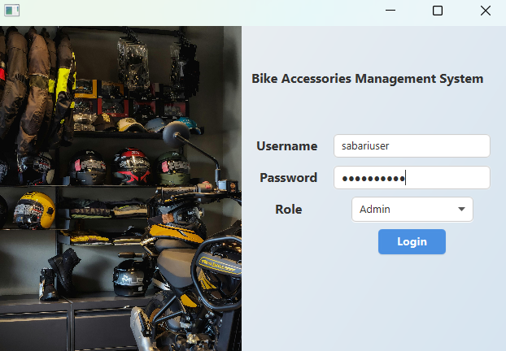
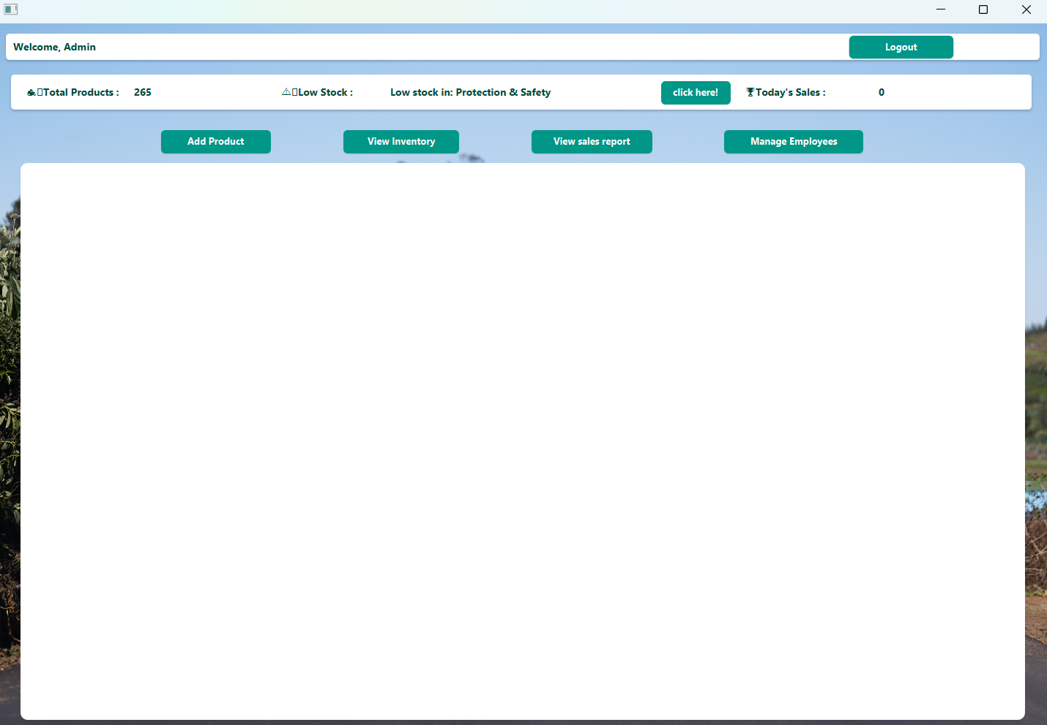
Admin login Admin Page

Slide 6
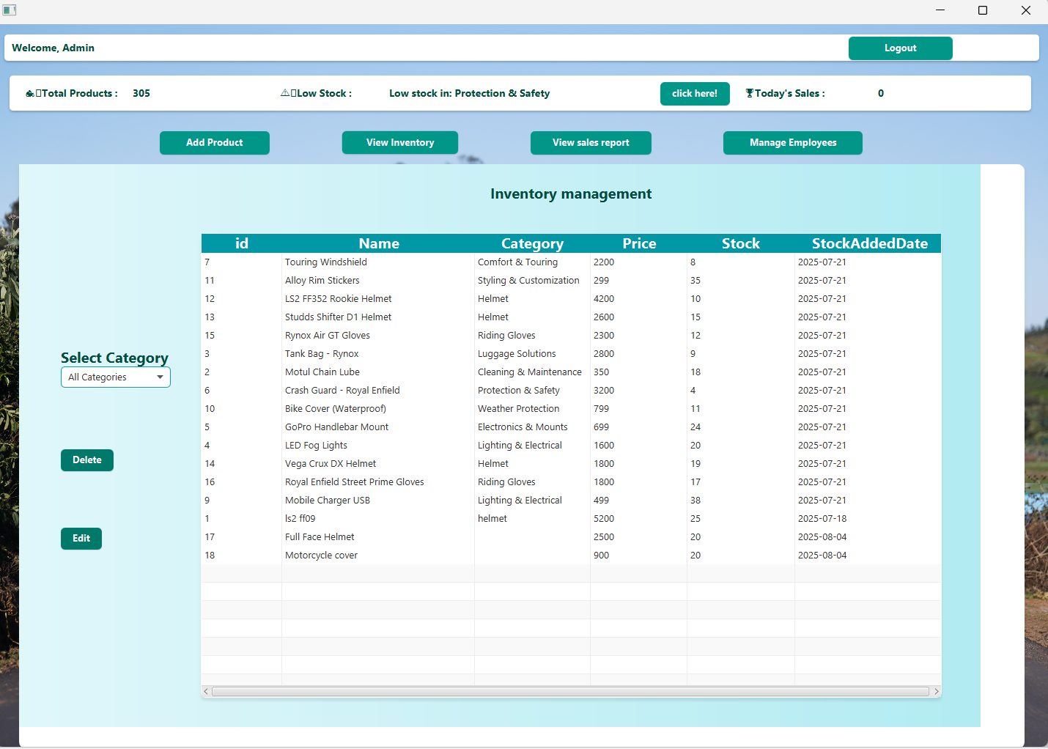
View Inventory

Slide 7
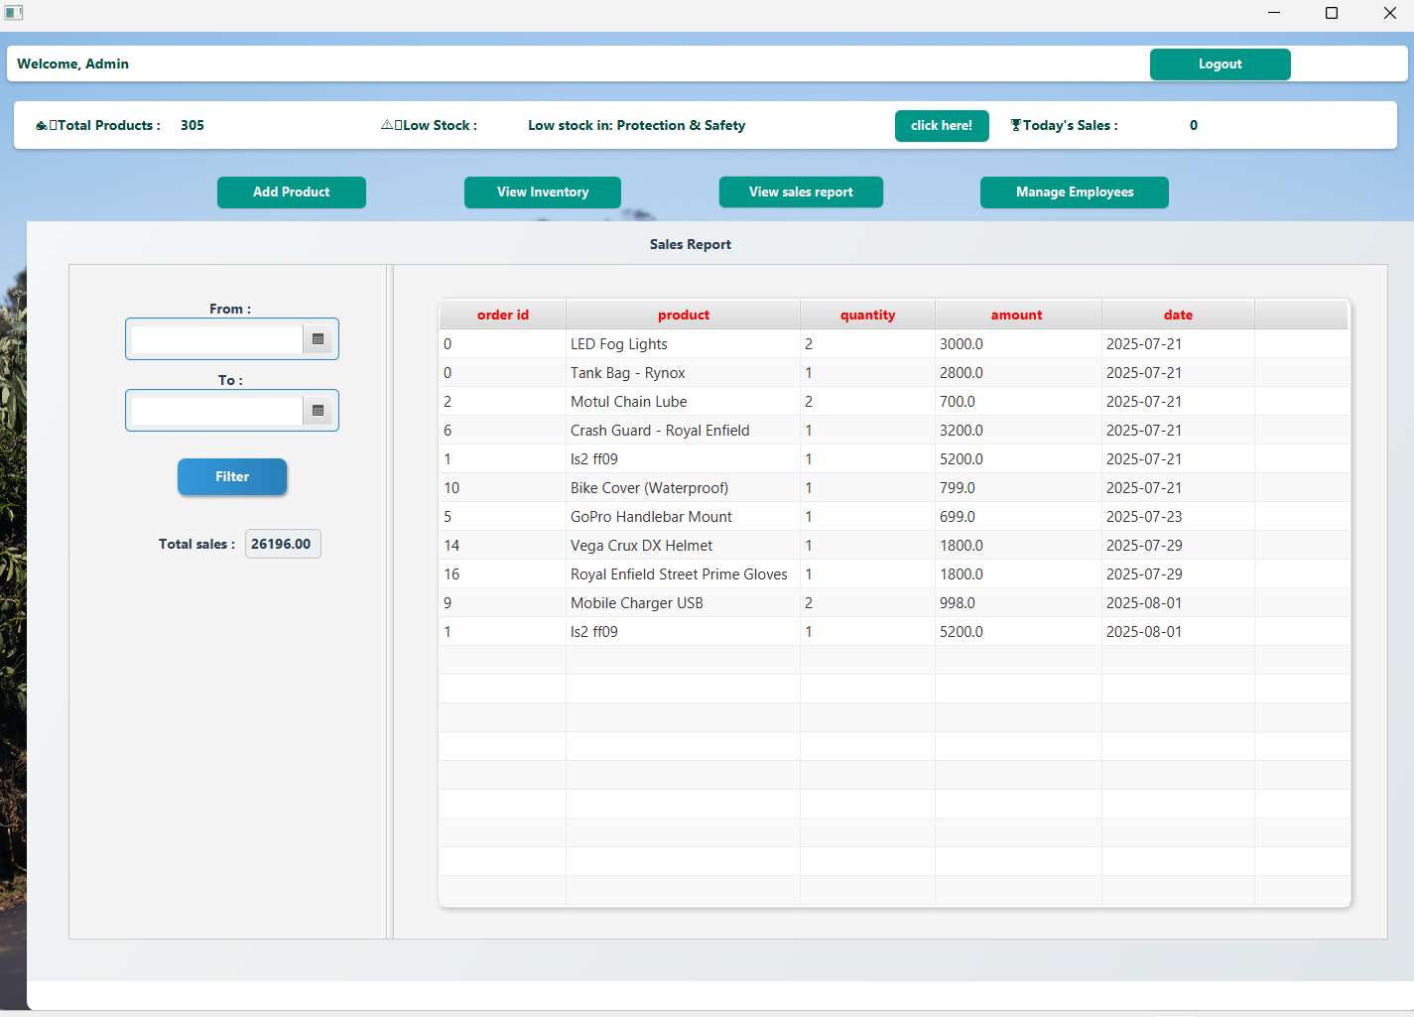
View sales report

Slide 8
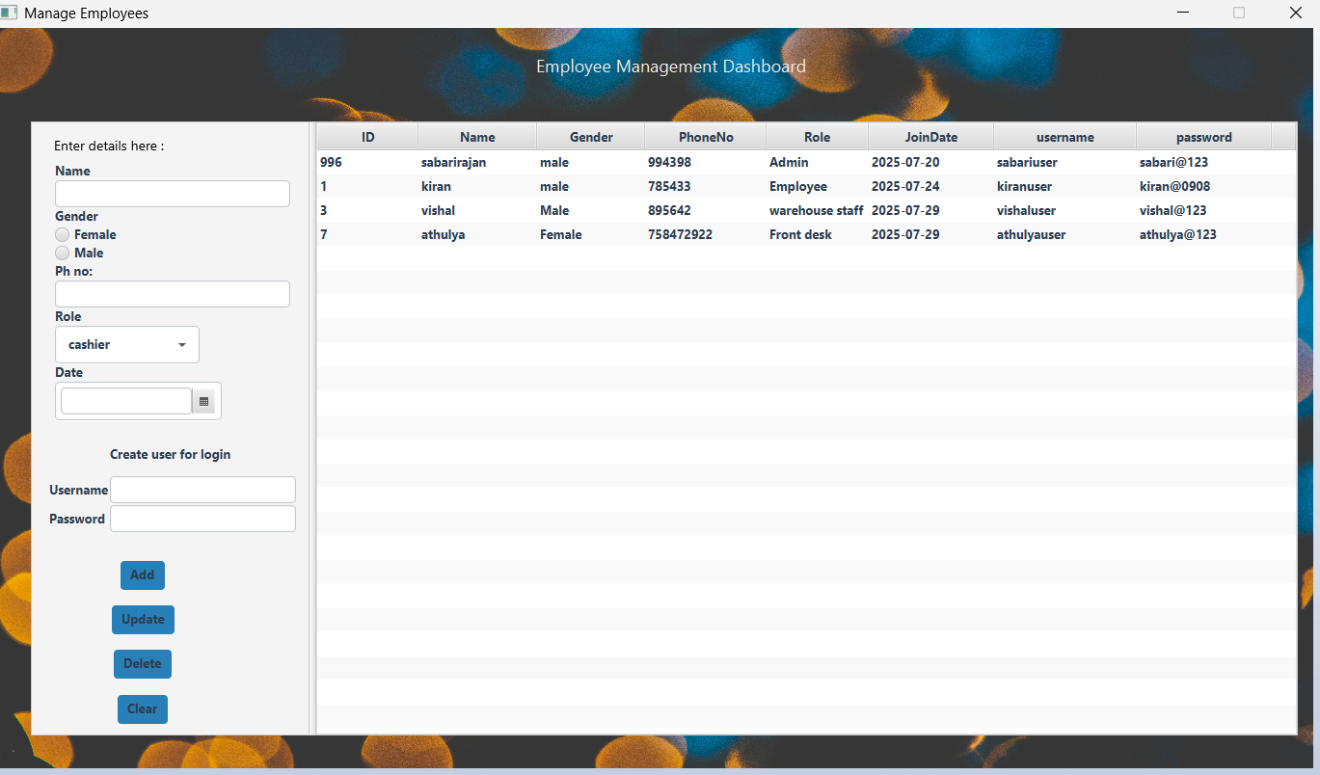
Manage Employees

Slide 9
Employee usage
Stock Viewing: View available stock and search by category.
Order Processing: Enter product ID and quantity to generate total price.
Payment Handling: Accept payments via cash, GPay, or card.
Confirm Sale: Click Confirm to finalize sale and update stock automatically.

Slide 10
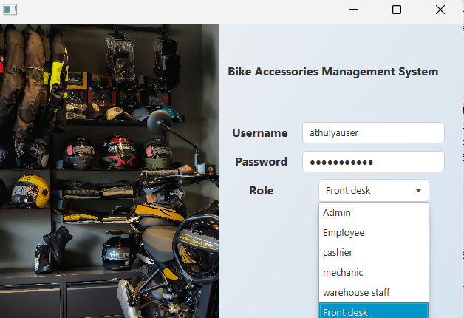
Employee Login Screen

Slide 11
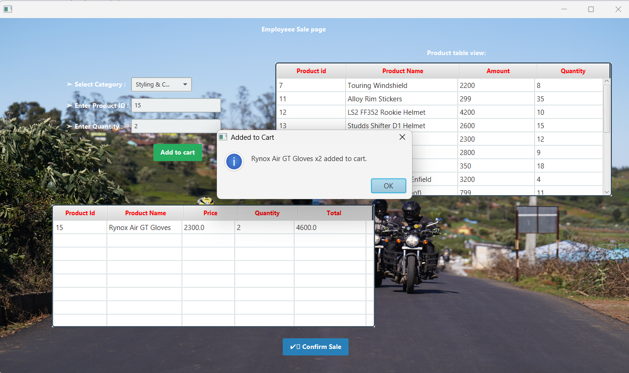
Employee page View

Slide 12
UI Design Process
UI Planning – Decided on the layout flow for Admin and Employee modules.
Scene Builder Design – Used JavaFX Scene Builder to visually design all screens (Login, Admin Dashboard, Employee Dashboard, Sales Report, etc.).
FXML Integration – Linked FXML files with corresponding Java controller classes for event handling.
CSS Styling – Applied custom JavaFX CSS for colors, fonts, and component styling.

Slide 13
Conclusion
Simplifies bike accessory inventory and sales management.
Saves time and reduces manual errors.
Provides a clear, role‑based interface for both Admin and Employee.

